Slide 1
Corrective Action Review for Calibration Meeting (May, 2014)
Team B:
Jim Carlisle, John Carlin and Rebeca Navarrete

Slide 2
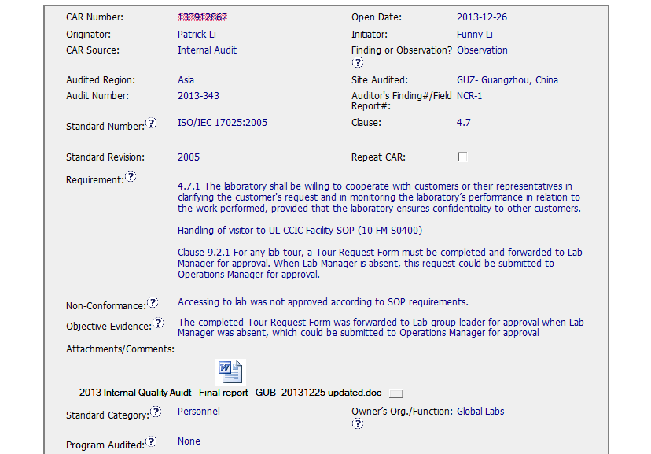
CAR 133912862 – Internal Audit

Slide 3
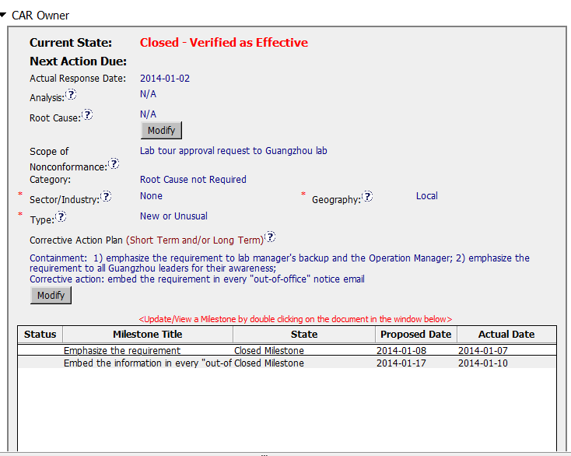
CAR 133912862 – Internal Audit

Slide 4
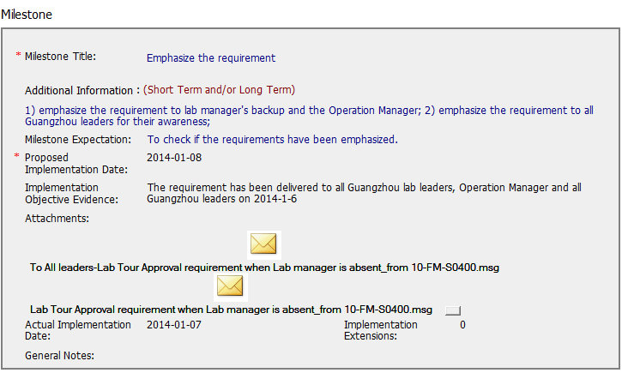
CAR 133912862 – Internal Audit

Slide 5
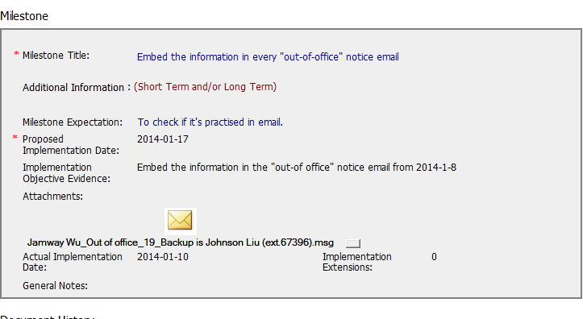
CAR 133912862 – Internal Audit

Slide 6
CAR 133912862 – Internal Audit
Questions:
Corrective action should have been a bit more specific. The embed was only relevant for the Lab Manager and that should have been stated.
CAR Admin did remove President from the line of escalation as required.
Overall appropriate and timely action taken. Moved along nicely by admin.

